Slide 1
ANNUAL MEETING – June 9th 2016

Slide 2
Agenda
11:45 Welcome & Agenda, Northern Lights Awards introduction
11:50 What’s New In Lighting Presentation
12:15 Northern Lights Award Voting & Intermission
12:30 Annual General Meeting Presentation
Election of 2016/2017 Board of Directors and Officers
1:00 IES Award of Recognition – Trina Larsen
1:05 Voter Prize Draw - $100 Visa Card
Submitter Prize Draw – Samsung Galaxy Tab S2
1:10 Northern Lights Award Winners
1:15 Closing remarks from 2016/17 IES Section 79 President
1:30 Adjourned

Slide 3
Northern Lights Award Submissions 2016
Presented by:
Benjamin Rajewski
&
Bridget Fox-Luzny

Slide 4
Northern Lights Award Voting Intermission
EXTERIOR
MacEwan LRT Station
Rosenthal Pond
Valley Zoo Entrance
John Fry Sports Park Pavilion
INTERIOR
Strathcona Dental Office
Primary Care Network
EPCOR North Service Centre
City of Edmonton Engineering Services
Meadows Rec Centre and Library

Slide 5
ANNUAL MEETING – June 9th 2016

Slide 6
AGM 2014/2015 Minutes

Slide 7
Thanks to Our 2015/2016 Board of Directors
President – Conrad Andrelunas
Vice President – Brent McCabe
Secretary – Vlado Cicovski
Past President & Treasurer – Trina Larsen / Christina Joe
Program – Bridget Fox-Luzny / Heather Chappell
Nominating & Membership – Katy Evans
Awards – Randy Phung
Social Media – Ryan Sonnenberg
Education – Sunil Nakai
Webmaster – Colin Fair

Slide 8
Thanks to Our 2015/2016 Co-Chairs, EP & Officers
Program Co-Chair – Deborah Savage
Education Co-Chair – Colin Wright
Emerging Professional & Social Media Co- Chair– Josh Bornia
Emerging Professional & Treasurer Co-Chair – Sergio Martinez
Emerging Professional & Education Co-Chair – Benjamin Rajewski
Emerging Professional & Awards Co-Chair – Derrek Ginnell
Emerging Professional & Nominating Co-Chair – Ian McGuiness
Emerging Professional & Program Co-Chair – John Kirstein
Officers - Daryle Tilroe
- Gerald Blouin
- Ken Glowinksi
- Glenn Stowkowy
Emotional Support – Steve Eriksen

Slide 9
Year 2 In Review
Goals
Increased involvement
Develop communication strategy
Continued program & education
Grow exposure for local projects
Results
5 new board members
6 emerging professionals
23 total!
Website, mail manager
Mailing list / newsletter
Social media
4 lunch and learns 2 advanced seminars 2 social events
Northern lights awards

Slide 10
Communications
Migrated our domain name to Squarespace
Developed new website
Set up mail manager with Mail Chimp for quarterly newsletter
Integration with email, mailing list and eventbrite
Continued social media presence through LinkedIn, Facebook, Twitter

Slide 11
Communications

Slide 12
Communications
Migrated our domain name to Squarespace
Developed new website
Set up mail manager with Mail Chimp for quarterly newsletter
Integration with email, mailing list and eventbrite
Continued social media presence through LinkedIn, Facebook, Twitter

Slide 13
2015/16 Events
June 25th – Picnic at Emily Murphy Park
July 15th – Year-2 Planning Session
September 19th – Advanced Lighting Control Seminar
Trina Larsen, Dave Hiemstra & Steve Erickson
September 30th – Emergency Lighting Lunch Seminar
Ian McGuinness
December 3rd – Leduc Library Tour
Bruce Knisley & Linus Murphy
January 27th – BIM and Lighting Design Lunch Seminar
Joshua Bornia & Sergio Martinez

Slide 14
2015/16 Events
March 5th – Advanced Lighting Design Process Seminar Trina Larsen & Dan Hadash
March 17th – Lighting and Health Lunch Seminar Robert Dupuy
May 4th – Power Over Ethernet Lunch Seminar
Trevor Peyton
Upcoming
July 20th – Year 3 Planning Session
July 27th – Summer Picnic at Rundle Park

Slide 15
Financials
Revenue:
Special Events: $4,856.79
Education – IES Training Course: $3,445.88
Annual Membership from IES: $ 496.08
Total Revenue: $8,798.75
- Unaudited -

Slide 16
Financials
Expenses:
Special Events: $ 2,900.47
Education – IES Training Course: $ 1,443.99
Business Meetings: $ 550.03
IES Bi-Annual District #6 Activity Fund: $ 0.00
Fees: $ 22.46
Northern Lights Awards: $ 942.18
Miscellaneous (Square Space Website): $ 247.00
Advertising (AAA Advertising) $ 561.75
Total Expenses: $6,667.88
- Unaudited -

Slide 17
Financials
Bank Balance:
End of May 2015 $ 6,900.16
End of May 2016 $ 9,031.03
- Unaudited -

Slide 18
Financials
 | 2013-2014 | 2014-2015 | 2015-2016
Revenue | $6,709.65 | $13,207.77 | $8,798.75
Expenses | $4,608.92 | $11,351.84 | $6,667.88
Profit | $2,100.73 | $1,855.93 | $2,130.87
- Unaudited -
Notes:
For future years – we should have a 3-year running total

Slide 19
Election of 2016/2017 Officers
President
Vice President
Secretary
Treasurer
Education
Program
Communications
Social Media
Membership and Nominating
Awards
Emerging Professionals
Officers

Slide 20
Benefits of Becoming a Section Officer
Leadership Skills
Build delegation and command presence abilities
Communication Abilities
Increase your persuasion skills by learning to market your section programs to members and potential members
Project Management
Design programs for your section that appeal to member interests
Enhance your research skills, find out what your membership’s interests are
Implement the development of compelling programs. Qualify program presenters that will engage your membership audience
Financial Skills
- Create budgeting for programs and events

Slide 21
President
Nominations:
Brent McCabe

Slide 22
Vice - President
Nominations:
Ryan Sonnenberg

Slide 23
Secretary
Nominations:
Katy Evans

Slide 24
Treasurer Co-Chairs
Nominations:
Sergio Martinez
Joshua Bornia

Slide 25
Program Co-Chairs
Nominations:
Bridget Fox-Luzny
Conrad Andrelunas

Slide 26
Education Co-Chairs
Nominations:
Benjamin Rajewski
Trina Larsen

Slide 27
Communications
Nominations:
Colin Fair

Slide 28
Membership / Nominating
Nominations:
Ian McGuinness

Slide 29
Awards Co-Chairs
Nominations:
Randy Phung
Derek Ginnell

Slide 30
Social Media
Nominations:

Slide 31
Emerging Professionals Chair
Nominations:
John Kirstein
Meghan Barkley

Slide 32
Officers
Glenn Stowkowy Colin Wright
Chris Barr Daryle Tilroe
Sunil Nakai Ken Glowinski

Slide 33
IES Edmonton Award of Recognition

Slide 34
IES Edmonton Voter Prize Draw
$100 VISA Gift Card
Just for voting!

Slide 35
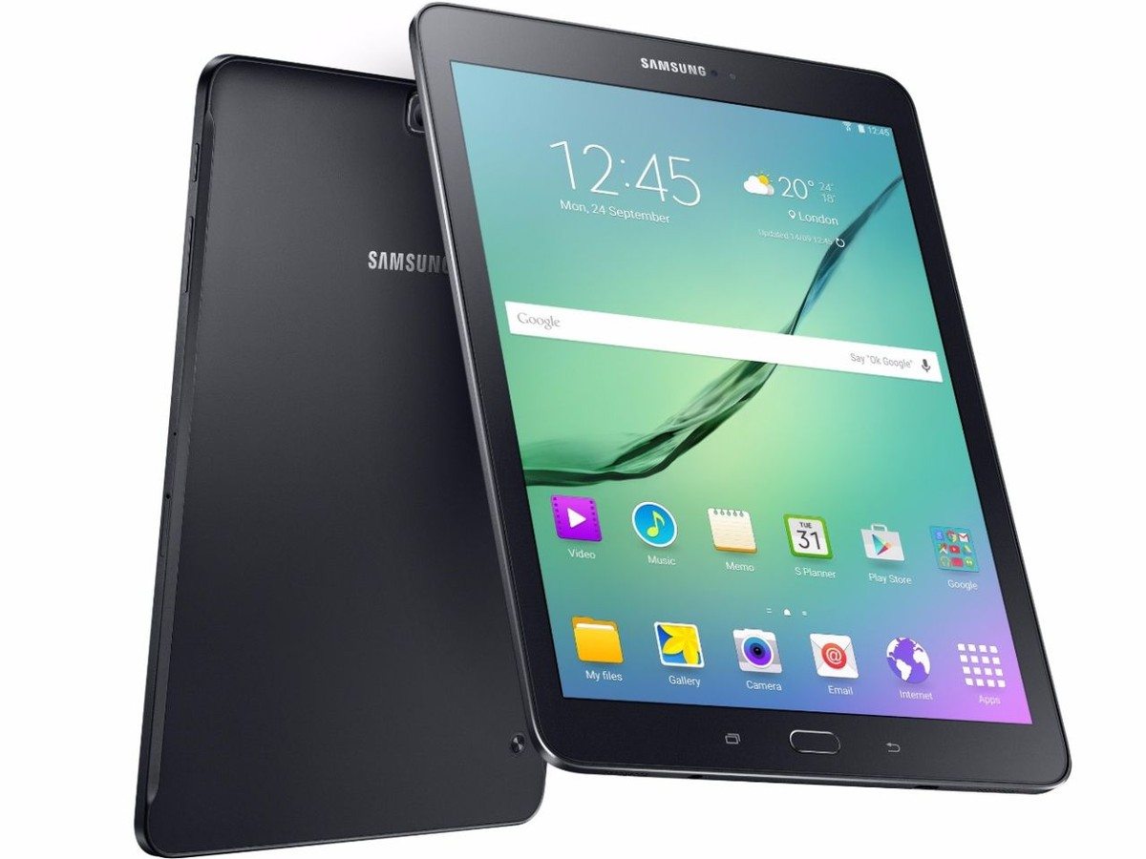
IES Edmonton Submitter Prize Draw
Samsung
Galaxy Tab S2

Slide 36
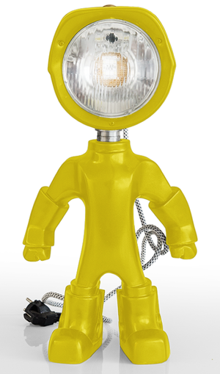
Northern Lights Award Exterior Lighting
EXTERIOR
MacEwan LRT Station
Rosenthal Pond
Valley Zoo Entrance
John Fry Sports Park Pavilion

Slide 37
Northern Lights Award Interior Lighting
INTERIOR
Strathcona Dental Office
Primary Care Network
EPCOR North Service Centre
City of Edmonton Engineering Services
Meadows Rec Centre and Library

Slide 38
Closing Remarks
Questions?

